Slide 1
Retrieval Practice
Aims: to explore effective feedback on retrieval tasks and the gradual removal of scaffold.
Notes:
HHO

Slide 2
Retrieval Quiz
Last Session | Last Month | Last Term
Name one possible pitfall of retrieval in the classroom. | What is the testing effect? | What is retrieval practice?
How can we add challenge to retrieval tasks? | How might we vary the conditions of retrieval practice? | Why is retrieval practice beneficial?
What is the ‘hyper-correction effect’? | Why is it important to vary the conditions of retrieval practice? | Name at least one retrieval activity.
Notes:
AJA

Slide 3
Experiences of Retrieval Practice
What gaps in knowledge did it reveal?
Were there any widespread misconceptions that arose?
What did students struggle with or excel on?
Were there any surprises? For example, students remembering more than expected or levels of confidence?
Would you do the task differently next time? If so, why? What worked or didn’t work?
Did the checking and feedback process present any challenges, particularly as delivered remotely?
Notes:
As you are now a way into your ‘revolution’ and the CPD on retrieval, it might be worth giving staff and/or subject areas time to do a bit of reflection on their experience using retrieval practice

Slide 4
Building Towards Higher-Order Thinking
Step One: Low Stakes Quizzing and Closed Retrieval Practice
Repetition, spacing and overlapping.
Step Two: Transitioning from Closed Retrieval Practice to Higher Order Retrieval Practice
Mix fact-based questions with questions which require further processing (start easy!)
Step Three: Higher Order Retrieval Practice
Essay/exam-style questions that require application of knowledge
Notes:
By now, staff should be well-versed in the idea that retrieval is more than factual recall. It is worth outlining the steps towards higher-order thinking beginning with building factual recall to mastery, then building in ‘how’ and ‘why’ questions to create mixed quizzes. Finally, approaching the more complex essay or exam-style questions which require students to apply all this knowledge. Explain that they should now be able to do this more successfully as repeated retrieval practice has enabled them to do certain things automatically thus reducing cognitive load for them to concentrate on the more complex thinking.

Slide 5
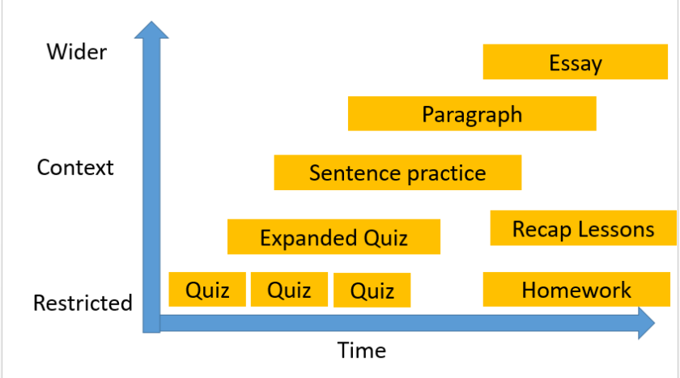
Notes:
This slide is taken from Tom Needham’s blog and shows how we might treat retrieval over time, beginning with massed retrieval quizzes#, working towards expanded quizzes with more challenging questions, building towards sentence level, paragraph level and finally essay level.

Slide 6
Mixed Retrieval Quiz
List the characters Iago manipulates in his plan to destroy Othello.
Why does Iago claim he wants revenge?
How does Iago bring Cassio down?
What is the link between Iago’s conversation with Montano and Cassio’s reputation?
For one of the characters you listed in question one, explain how Iago manipulates them.
‘Rhetoric is the art of ruling the minds of men.’ Explain this statement.
Notes:
Slide 5-9 are examples of mixed quizzes (step two) thanks to Kate Jones & Matthew Lynch for the retrieval pyramids!

Slide 7
Retrieval Pyramid
Using a Retrieval Practice Pyramid is a brilliant way to go beyond just recall.
Starting with factual recall then scaffolding the style of questions for more complex, more elaboration and higher order thinking. The design helps to build from the base to the top – from simple factual recall questions to more evaluative and synthesised ideas.

Slide 8




Macbeth: Retrieval Pyramid – the supernatural
How far is Macbeth a victim of supernatural forces beyond his control?
Give 3 examples of seemingly supernatural events in the play.
Give 3 examples of disruption to the natural order after the regicide.
Which character describes the witches as “instruments of darkness”?
Explain how Banquo’s reaction to the witches differs from Macbeth’s.
Is ‘gullible’ an apt word to describe Macbeth? Explain why – or why not.
List 3 weather conditions described in Act 1 scene 1
Where do the Weird Sisters say they will meet Macbeth?
What is significant about Macbeth’s first words in the play?
“By the pricking of my ______ , something _____ this way comes.”

Slide 9
An Inspector Calls: Retrieval Pyramid – Responsibility
Who, in your opinion, behaves most irresponsibly in the play? Justify your reasons.
How, if at all, does Gerald’s treatment of Eva differ from Eric’s?
How is Sheila’s reaction to blame different from her mother’s?
Explain briefly how each character behaves in an irresponsible manner.
Which characters are unrepentant by the end of the play?
Are Eric’s crimes of assault and theft different from the immoral behaviour of others in the play?
Which character insists: “I can’t accept any responsibility?”
What 3 things does Goole predict will happen “if men do not learn that lesson?”
Which character asks: “So, I’m really responsible?”
Which character blames
“the girl herself” ?

Slide 10
A Christmas Carol: Retrieval Pyramid – Scrooge’s spiritual journey
Which spirit do you think has the greatest impact on Scrooge? Justify your ideas.
What things does the final spirit teach Scrooge, without words?
Who are Ignorance & Want, and what do they represent in the novella?
What things does Scrooge learn from re-visiting his past?
Explain the symbolism of Marley’s chains and the items attached to it.
Explain how Fred and Fezziwig are the antithesis of Scrooge.
Complete the quotation:
“I ______ the _______ I ______ in life.”
Explain why Scrooge is associated with cold and ice in Stave One.
Recall 2 similes used to describe Scrooge in Stave One of the novella.
Is Scrooge a static or a dynamic character? Explain why.

Slide 11
’England in 1819’
By Percy Bysshe Shelley
Starter: Re-write the following sentences adding in relative clauses
[Insert writer/ poem] | Who/ which/ that … | Is presented as ... since …/ is important because …
Blake, who held largely anti-establishment views, bemoans the use of child exploitation during the industrial revolution.
‘The Chimney Sweeper’, which…. , tells the story of a young boy sold into child labour.
Wordsworth celebrates the achievements of Toussaint Louverture.
The Peterloo Massacre inspired Shelley to write a protest poem.
‘England in 1819’ criticizes the establishment.
Notes:
This activity and the one on the following slide was actually made by a member of my department but I think it is a great way of getting students to practise the skill of sentence crafting in a way that also activates their prior knowledge.

Slide 12
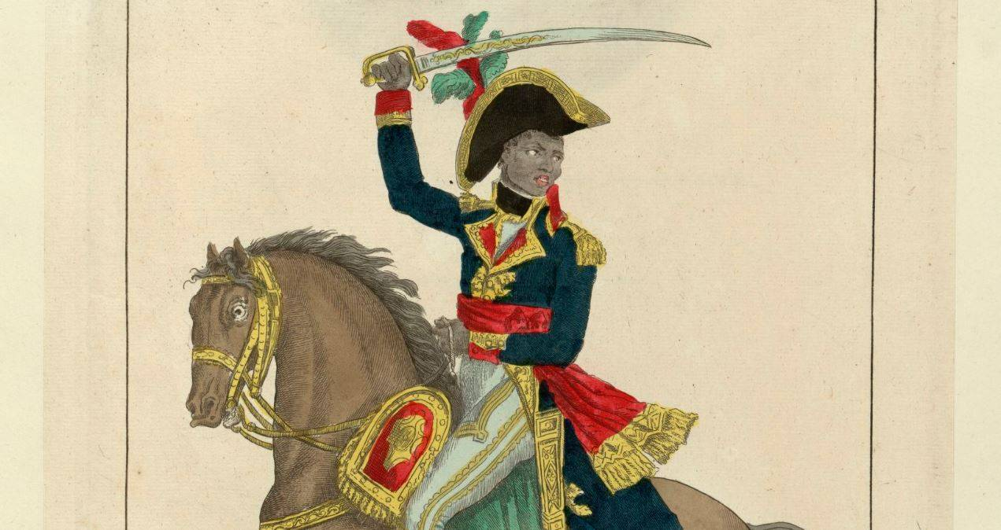
Complete the following sentences by adding embedded clauses with present participle phrases
Wordsworth tries to comfort Louverture.
E.g. Wordsworth, supporting revolutionary ideals, attempts to comfort Louverture.
Wordsworth presents Louverture as inspirational.
Wordsworth, [critiquing…], presents Louverture as inspirational.
Wordsworth reveres Louverture for his revolutionary work.
Wordsworth, [revealing,…] reveres Louverture for his revolutionary work.
Wordsworth condemns slavery.
Wordsworth presents Louverture as a force of nature.
Present Participle Verbs
Alluding bemoaning condemning connoting constructing contradicting contrasting creating critiquing developing devising encapsulating Epitomising | establishing exploring exposing expressing illustrating implying indicating insinuating intimating juxtaposing opposing | outlining referring reinforcing representing revealing showing signifying suggesting supporting symbolising typifying

Slide 13
Higher-order Retrieval Tasks
DO NOW: You have 5 minutes to answer the question…
Why is Prospero a controversial character?
Include:
The word ‘colonialism’;
A noun appositive;
A present participle verb to add further explanation e.g. revealing…
Notes:
Slide 13-15 show higher-order questions with criteria that add challenge but are still examples of retrieval as they require prior knowledge to be answered successfully

Slide 14
Higher-order Retrieval Tasks
DO NOW: You have 5 minutes to answer the question…
What is the connection between The Divine Rights of Kings and Macbeth?

Slide 15
Higher-order Retrieval Tasks
DO NOW: You have 5 minutes to answer the question…
How are contrasts significant in An Inspector Calls?
All of these questions are asking for higher order cognitive processing, ensuring that there is a close link between the practice and final test. However, if students are to produce high quality answers to these questions, it is often important to have previously asked them more restrictive retrieval questions on the required components. This process reflects the journey from inflexible to flexible knowledge: well planned and carefully sequenced retrieval tasks can help students move along this continuum. While initial quizzing may be factual and restrictive, later retrieval tasks will look far more like what is expected (extended writing).

Slide 16
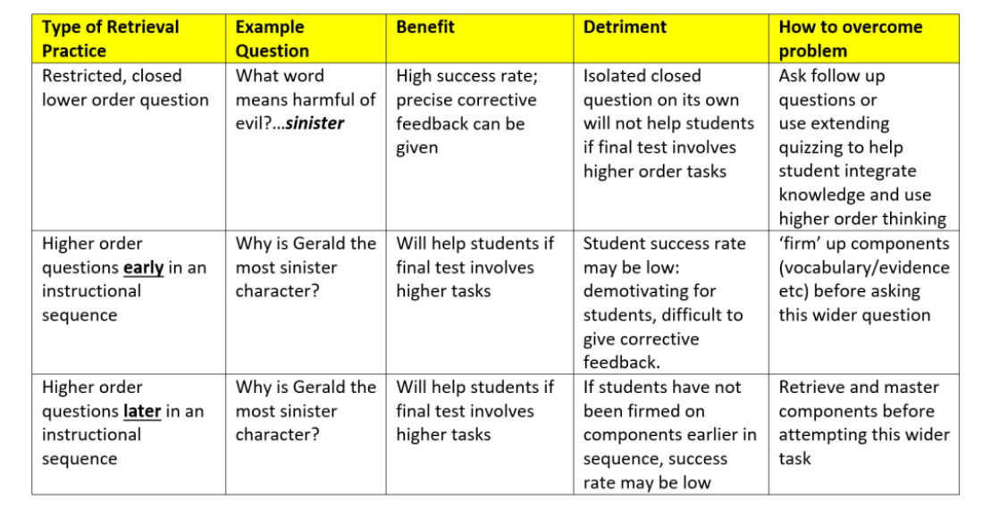
Notes:
This slide is also taken from Tom Needham’s blog and might be worth sharing with staff as it neatly outlines different types of retrieval practice with examples, pros, cons and how to overcome pitfalls.

Slide 17
Design a Mixed Retrieval Quiz
This could be a retrieval pyramid, Memory Platform or standard quiz that is scaffolded to become more challenging.
Notes:
The rest of this training session could be spent in departments designing mixed-quizzes or using the table on the previous slide to plan lots of different types of retrieval across a scheme, term or topic.

