Slide 1
Retrieval Session Two
Aims: to explore effective implementation of retrieval in the classroom

Slide 2
Retrieval Quiz!
What is ‘the testing effect’?
What does Ebbinghaus’ forgetting curve tell us about newly-learned information?
What is spacing and why is it important?
What is schema and what does it show us about memory?

Slide 3
Retrieval Quiz!
‘The testing effect’ is a phenomenon that states taking a test on studied material promotes remembering that material on a final test.
The Ebbinghaus forgetting curve shows how learning is forgotten over time if not revisiting after a gap (spacing effect).
Spacing is revisiting learning after a gap (just before it is forgotten) in order to prevent forgetting.
Schema is how we make sense of new information: by connecting it to existing knowledge. It shows how making links between different learning and ideas helps strengthen memory.

Slide 4
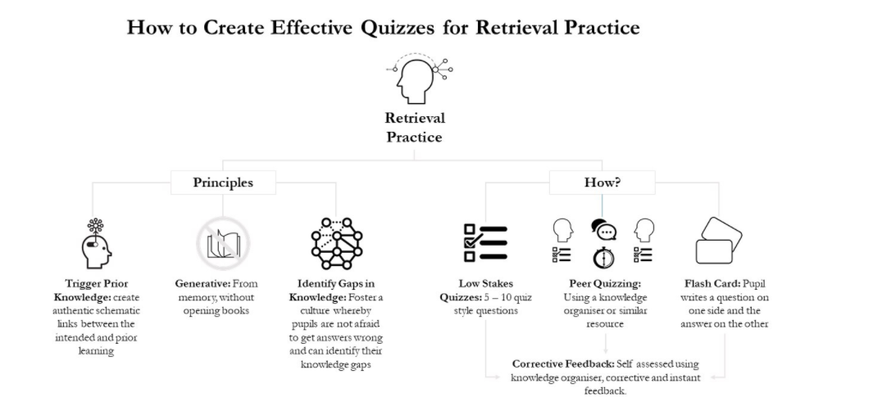
Notes:
Image taken from this blog: Retrieval Practice and the Art of Schema Building – Mr Goodwin (wordpress.com)
Explain that for retrieval to be effective, it needs to activate prior knowledge and be closed-book (from memory). It should be an assessment tool by identifying gaps in knowledge for both students & teachers. All retrieval should be low-stakes (no scores recorded etc.) and it may take the form of peer quizzing or flashcards i.e. it does not need to be a teacher-written test (more on this later in the session). Corrective feedback is an essential part of retrieval so that students can see their strengths and weaknesses immediately afterwards.

Slide 5
Retrieval in the classroom: pitfalls to avoid
Teachers might generate retrieval questions that focus solely on factual recall (these questions are easier to generate) rather than requiring any higher-order thinking.
Questions might be too easy and boost confidence without providing real challenge, which is likely to be a key ingredient for generating the kind of learning hoped for.
Teachers might allocate too much time to the quizzes, effectively losing the time they need to cover new material.
students copying out the answers from their books: this clearly involves no thinking whatsoever and negates the ‘thinking hard’ part of retrieval practice as well as preventing any type of assessment of learning by either student or teacher;
lack of feedback: if students do not receive corrective feedback on their retrieval tasks – however this may look – the task will add no value to their understanding of the topic.
Notes:
Explain that the most effective form of retrieval builds up to more difficult questions (mixed retrieval quizzes) and we should make sure our retrieval does not only test factual recall, therefore, providing challenge. They need to be time-efficient: time spent on retrieval is time well-spent but we need to ensure it doesn’t take over curriculum content. It must be closed-book and it might be worth considering having separate retrieval exercise books to allow this to happen. There must be corrective feedback so that mistakes are not ingrained in memory.
.

Slide 6
Feedback: The Hyper-correction Effect
Instant, corrective feedback means students benefit from the hyper-correction effect: the more confident students are that their answer is correct, the less likely they are to repeat the error if corrected.
Learners need to experience a high success-rate before they move onto higher-order, essay-type questions.
Notes:
Building on the importance of corrective feedback, explain the hyper-correction effect: it is worth getting students to rate their confidence with each answer prior to feedback to avoid them repeating mistakes.

Slide 7
 | Very confident
 | Not so confident
 | Need to revise
Question | Answer | RAG answer | Actual answer – was I correct?
What word means harmful or evil?
What is Othello’s hamartia?
What are the characteristics of a tragic hero?
What are Iago’s motives?
What does ‘manipulate’ mean?
Notes:
This is a possible template using the hyper-correction effect where students rate their answers prior to feedback. Another way of doing this is getting students to rate themselves on a scale of 0-100. This may need careful modelling though. Students should not randomly allocate a rating. They should think about what their revision suggested about how well they know X, Y and Z. For example, could they answer immediately & correctly? Were they hesitant? Were they completely unsure?

Slide 8
Four steps of metacognition (Agarwal & Bain)
Students place a star next to any answers they know and a question mark next to any they don’t.
Students answer all the questions they have marked with a star.
Students look up the answers to all the questions they have marked with a question mark.
Students verify all the starred answers are correct.
* | ? | Items to know | Answer
 |  | Definition of ‘hubris’
 |  | How did Macbeth’s hamartia create his downfall?
 |  | Divine Rights of Kings
 |  | Why does Macbeth descend into tyranny?
Notes:
In Powerful Teaching, Agarwal and Bain suggest this approach to retrieval where students use a key to show awareness of what they do and don’t know and then spend time finding the correct answers.

Slide 9
Varying Conditions of Retrieval Practice
practise explaining something verbally in pairs
Use their knowledge to demonstrate why a particular argument/thesis statement is true
close books and engage in a discussion using the vocabulary they’ve learned
produce a timeline or essay plan exploring how a character in a novel develops as the story progresses
engage in a paired questioning exchange, devising and exchanging questions and answers
Notes:
Explain that ideally the conditions of retrieval need to be varied to avoid teachers always directing students to particular test questions. The suggestions on this slide involve going beyond factual recall by using knowledge to develop explanations.

Slide 10
Adding Challenge in Retrieval Practice
Spacing – the longer the gap between initial teaching and retrieving, the harder the information will be to retrieve.
Extended questioning – it’s important that in feedback, teachers ask ‘why’ and ‘how’ questions to extend students’ thinking to higher-order ideas.
Mixed Retrieval Quizzes – quizzes that build from factual recall to more challenging ‘how’ and ‘why’ questions that reflect the high-order processing they will need to use in an essay/exam
Linking – getting students to draw similarities and differences with other schemes/texts/characters/themes will add challenge and aid memory through schema-building.
Notes:
Including challenge in retrieval is also important although we should build up to this. Desirable difficulties in retrieval include spacing, ‘how’ and ‘why’ questions, mixed quizzes and drawing connections across learning.

Slide 11
Planning Retrieval for your Subject Area
In departments, use the retrieval strategies document to plan some retrieval for a year 7 scheme of work that gradually reduces scaffold or cues to work towards mastery and automaticity.
Questions to consider:
How will you build factual recall?
How will you incorporate spacing?
How will you incorporate the hyper-correction effect?
How will you ensure there is immediate corrective feedback?
Notes:
Give time for departments to design their own retrieval activities for the first year 7 scheme of learning – what will these look like and how will they build from factual recall to more complex thinking? How will cues gradually be reduced? How will principles such as spacing and the hyper-correction effect be taken into account?

