Slide 1
Creating a Revision Revolution!
Aims: to explore the science behind effective revision and retrieval.

Slide 2
Traditional vs Effective Revision
Traditional revision | Effective revision
Completing past papers Re-reading notes Highlighting Cramming Or possibly non-existent! | Retrieval Spacing Dual-coding Interleaving Concrete examples A regular habit as all strategies explicitly modelled to students across the school

Slide 3
Retrieval Quiz on The Science of Learning
1. What is retrieval practice?
2. List as many benefits to retrieval practice as you can remember.
3. Name one retrieval activity and how it works.
4. What should we bear in mind when setting retrieval tasks?

Slide 4
Retrieval Quiz on The Science of Learning
It is a powerful strategy that involves pulling information out of students’ heads, rather than cramming information into students’ heads.
Trying to remember something is active (rather than passively re-reading); it helps students monitor their knowledge and avoid over-confidence; it creates higher-order learning and long-term retention.
Brain Dump, Concept Map, Repeat Back, Think-Pair-Share, Flashcards…
They should be used regularly, not just at the end of a scheme and students need constructive feedback for them to be memorable.

Slide 5
Notes:
Analogy of learning to drive to demonstrate importance of retrieving information easily and automatically to reduce cognitive load and focus on more complex thinking. Perhaps needs a roadmap type image?

Slide 6
Which of these study patterns is most likely to result in long-term learning?
study study study study – test
study study study test – test
study study test test – test
study test test test – test
Having just one study session, followed by three short testing sessions and then a final assessment, will out-perform any other pattern.
Traditionally, schemes of work and curricula have been designed according to study pattern one but there is evidence to suggest a rethink.
What students need – in school and at home – is extended practice, overlearning, testing and revisiting.
Notes:
Taken from Didau blog (cited in book)
Although schemes of work & curriculum are often set up to mirror version one, it is version four is actually the most effective, suggesting that we should spend a lot more curriculum time testing students’ on prior learning.

Slide 7
Schema-building
We organise ideas, knowledge, learning into patterns of connected information called schema.
Notes:
Debunk the idea that memory is simply factual recall, it is much more. Each item of knowledge that is stored in long-term memory forms part of a wider schema – new knowledge is understood in terms of existing knowledge and is connected together to form an ever-growing schema. As Dan Willingham explains in Why Don’t Students Like School, understanding is remembering in disguise. Not only this but we remember what we think about (‘memory is the residue of thought’ – Willingham) so the more we activate students’ prior knowledge (i.e. make them think about it), the more they are likely to remember and understand it.
.

Slide 8
Ten Benefits of Retrieval Practice (Agarwal & Bain)
Improves students’ learning and retention of information over the long-term;
Increases students’ higher-order thinking and transfer of knowledge;
Identifies students’ gaps in knowledge, which provides formative assessment for teachers and students;
Increases students’ metacognition and awareness of their own learning;
Increases students’ engagement and attention in class;
Increases students’ use of effective study strategies outside of class;
Increases students’ advance preparation for class;
Improves students’ mental organisation of knowledge;
Increases students’ learning of related information that isn’t initially retrieved;
Increases students’ learning in the future by blocking interfering information.
Notes:
Taken from ‘Powerful Teaching’ (cited in book). Outline the multiple benefits of retrieval practice!

Slide 9
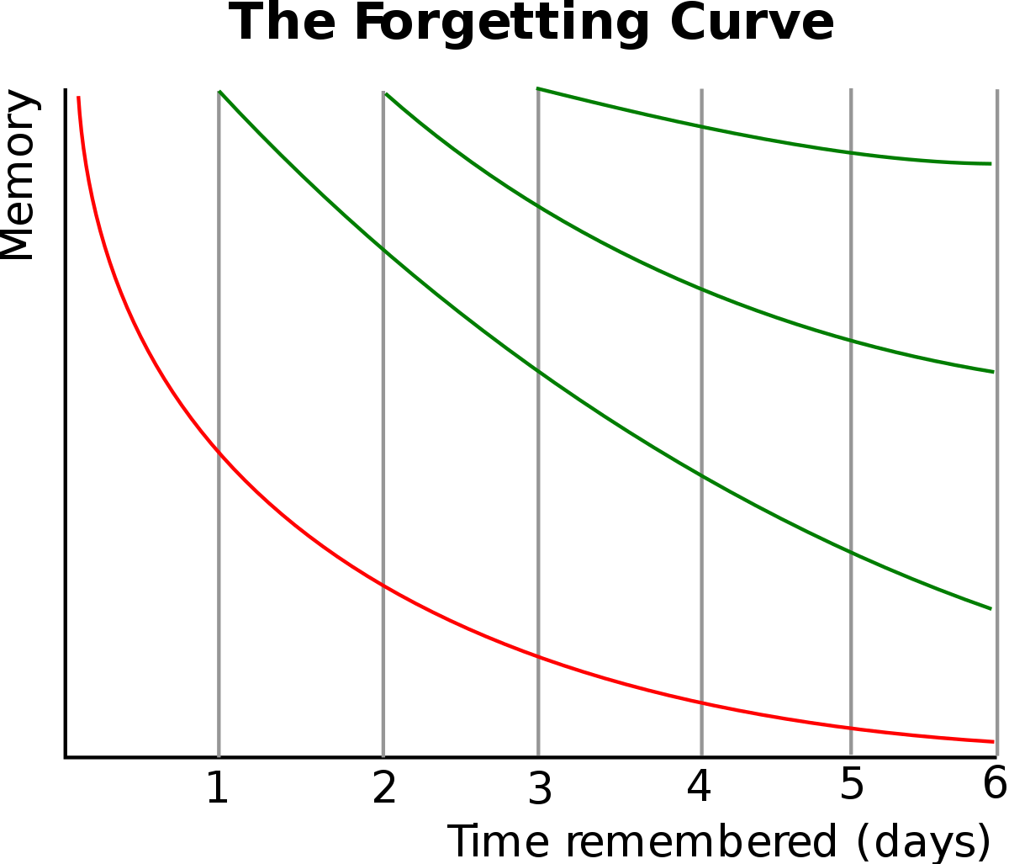
Typical Forgetting Curve for Newly-Learned Information
Notes:
Show Ebbinghaus’ forgetting curve to demonstrate the importance of retrieving information after a gap to avoid forgetting. Agarwal & Bain explain this concept really simply in Powerful Knowledge: ‘with knowledge, we either use it or lose it’!

Slide 10
What is the powerful knowledge in your subject area that you want students to remember?
What knowledge do you want students to retain at KS4 & KS5?
What knowledge will add to students’ Cultural Capital?
What knowledge will enable students to be part of ‘the conversation’?
What knowledge opens doors, enables choice and opportunities?
You may want to consider important concepts in your subject and/or your subject’s ‘canon’, tier two and three vocabulary, key skills (knowing how)…
Notes:
Give subject areas time to reflect on their curriculum and consider what the powerful knowledge is in each scheme (perhaps begin with KS3) that they want to repeatedly test in retrieval quizzes. Session two will explore a range of strategies for testing that knowledge.

