Slide 1
Building a Culture of Effective Study
Helen Howell: author of The Revision Revolution

Slide 2
How do students perceive revision?
66%
linked revision to tests, assessment and exams & thought you should only revise before a test.
Negative associations:
boring, difficult, stressful, don’t know how to do it.
“Habits are context-dependent, automatically-initiated behaviours. Habits can be overridden with conscious effort, but when people feel rushed or tired, they are more likely to fall back on old habits.” (Wood and Runger, 2015)

Slide 3
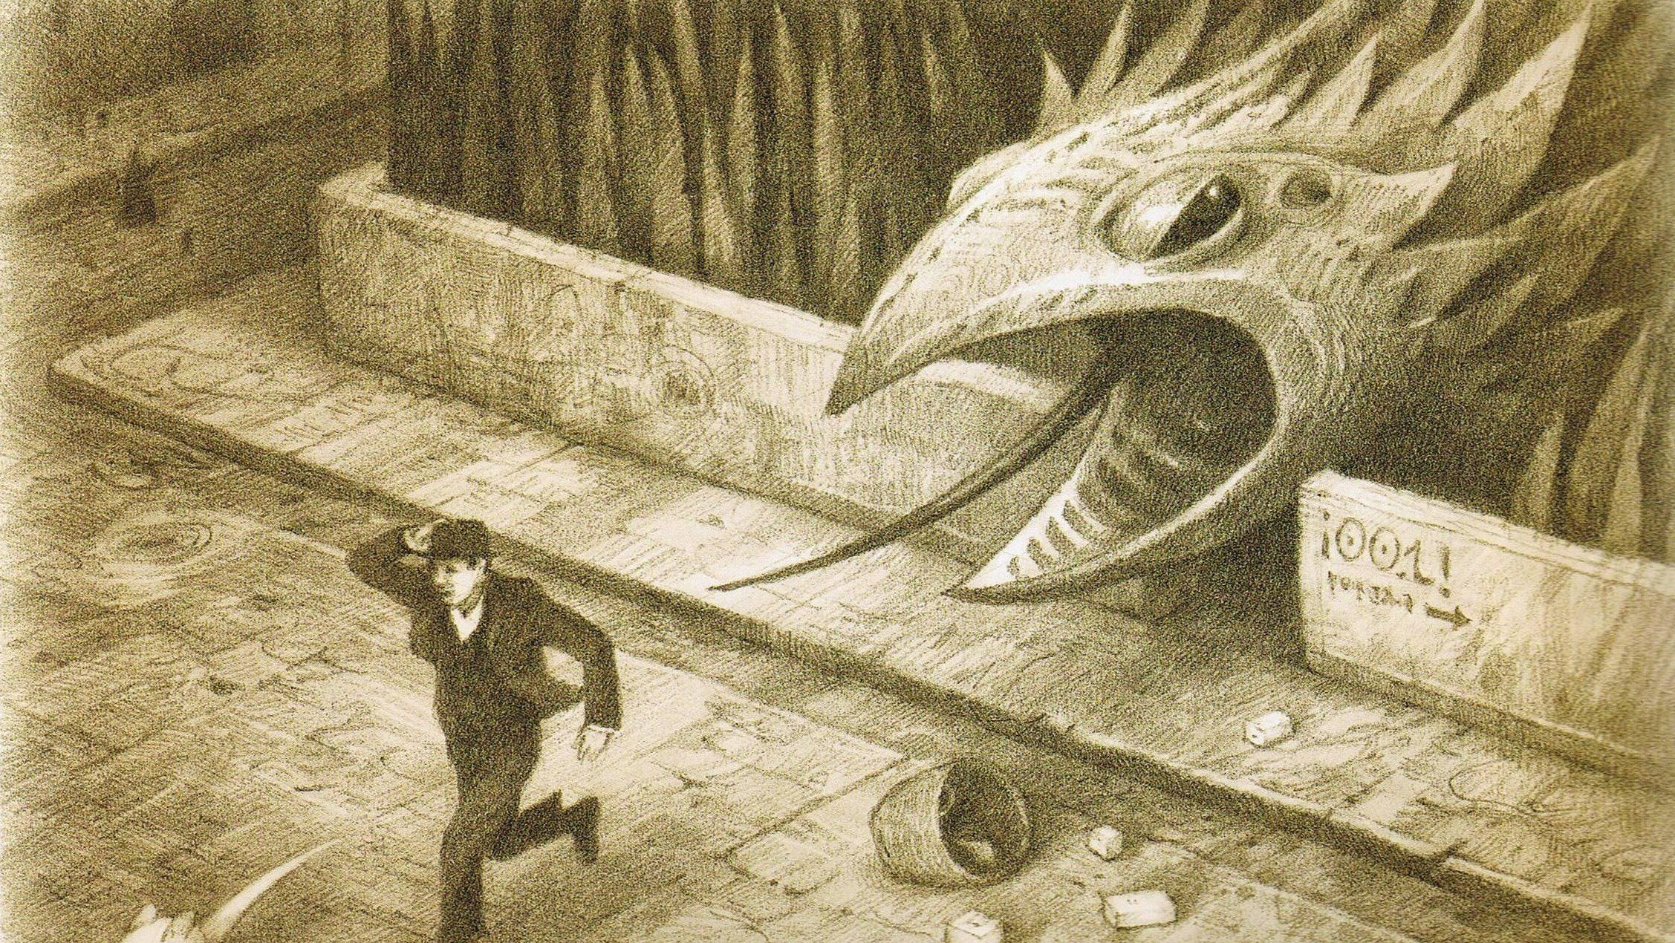
Revision: ‘the established way’
Revision just for exams.
Revision as something mysterious or unattainable.
Revision as a solitary & silent activity.
Fear of failure.
Revision for more privileged students with tutors, family support and a conscientious group of friends.
Cramming.
Last minute interventions.
After-school revision ‘free for all’ that has little impact.
A chasm between revision at school and study skills needed for further and higher education.
Little/no understanding of strengths and weaknesses.
Threatening language.
Completing past papers
Re-reading notes
Highlighting
Or possibly non-existent!
Little or no modelling of how to revise

Slide 4
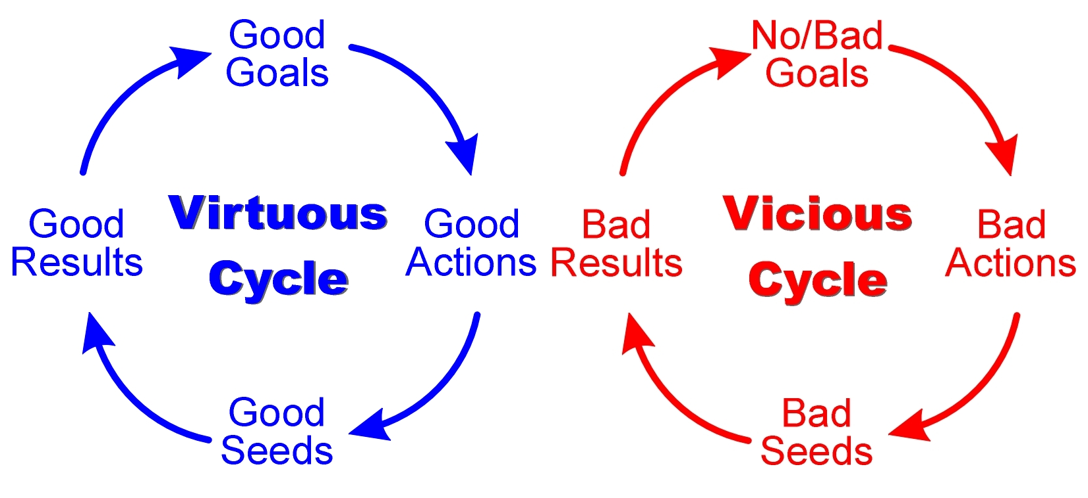
Students know how to revise. They set goals & reflect independently
Students don’t know how to revise. No goals.
Students revise effectively & routinely, selecting the most appropriate strategies
Students experience success
Students experience failure
Students don’t revise or revise ineffectively
Students have a negative perception of revision (anxiety, stress, being told off…)
Students have a positive attitude towards revision

Slide 5

The Science of Memory: why ‘the established way’ does not work
Recall or retrieval is essential for allowing knowledge to enter long-term memory.
Generative learning activities such as self-explaining and teaching are effective strategies for remembering key information – this is why oracy is so powerful.
Spaced or distributed practice is much more effective than cramming!
“Metacognition isn’t just a buzz word – it is a powerful concept that helps students evaluate their current thought processes so that they can improve.” –InnerDrive

Slide 6
A Study Skills Curriculum
THE ‘WHY’: students understand the principles of effective revision through a centralised cognitive science curriculum.
THE ‘HOW’: students have a toolbox of strategies to use for effective revision that are repeatedly modelled to them in lessons.
‘WHY’ & ‘HOW’ combined: students can independently revise at home by selecting tools from their revision toolbox that are both effective and non-threatening. There is a clear connection between the powerful knowledge of the curriculum, assessment and revision. Ideally, there is a shared understanding of this.
A powerful part of learning;
Active, not passive;
Purposeful;
Explicitly modelled;
A regular habit from year 7 or earlier: study is normalised;
Metacognitive;
Accessible for all, low threat, guaranteed success;
Desirable difficulties;
Spaced and interleaved;
Enables a smooth transition between school and further and higher education;
A semantic shift to positive language and shared dialogue;
Social!

Slide 7
A Study Skills Curriculum
Ineffective (traditional) approaches to study | Effective approaches to study
Highlighting Re-reading Last minute interventions Past papers Cramming No modelling of how to study effectively Silent and solitary Goal-orientated: to pass exams Too difficult and abstract to attempt Short-term | Retrieve-taking Self-quizzing Teaching: stories and analogies Self-explaining Spaced and interleaved Metacognition Social – with a buddy! Study as normalised part of learning Desirable difficulties: active & accountable revision Life-long study skills and habits Dual-coding Elaboration Concrete examples

Slide 8
What does a self-regulated learner need to know?
Strategies that “support meaningful knowledge construction and long-term retention, not rote memorisation and short-term performance” (Mayer, 2002)
Processing information is an important part of meaningful learning, using generative activities to “select, organise and integrate” information into broader knowledge networks. (Fiorella and Mayer, 2016). Pre-testing and self-explaining are two such examples.
Revision: the need to repeatedly return to previously studied information for it to enter long-term memory (not cramming for a test!) Sequencing matters.
Students benefit from testing themselves before, during and after study.

Slide 9
Increasing Student Self-Efficacy
Although retrieval is used routinely in many classrooms, do we make students explicitly aware when we are using it and the pedagogical benefits? For example, do we explain to students that completing some free recall on a topic can help direct their study session, enabling them to focus on the areas most in need of attention?
There is also a need to ensure students have a range of resources to use for retrieval practice e.g. Cornell notes pages in their exercise books, flashcards and scholarly texts.
Low efficacy strategies such as re-reading and highlighting are much more straightforward which is part of the reason students will naturally revert back to them if we don’t actively discourage this!
Lack of spacing – involves planning ahead: this requires a culture shift in education where revision is not just linked to tests or completed shortly before tests, assessments and exams.
Motivation: reframing ‘active’ strategies as more interesting than low efficacy, passive approaches such as re-reading and highlighting. Students can use engaging strategies such as teaching, paired quizzing and flashcards that are not only active but also allow all students to experience success in their revision.
Effective strategies take more time = myth!
They make study much more efficient!

Slide 10
“An important distinction between more and less effective strategies is how cognitively active they are.” (Rea et al, 2022)
Passive to Active: Retrieve-taking
Retrieve-taking is very slightly different to note-taking in that instead of reading over notes and trying to commit them to memory (a low efficacy strategy), this is made active and turned into a desirable difficulty:
Teacher pauses the lesson.
Students open up a blank page or turn to the backs of their books.
Students note down what they remember, retrieving the information from memory – they have to think hard about the content!
Teacher provides corrective feedback.

Slide 11
Passive to Active: Peer Coaching
Questioning: how and why?
Paired quizzing
Tip Tip Teach Try Again (no opt out!)
‘Just a minute’: students talk for one minute on a given topic. Hesitations cost a life – three strikes and you’re out!
Give me three: Tell me three important vocabulary words from this topic, what are three important facts? Give me three alternative methods you could use to approach this problem.

Slide 12
Retrieve: students must retrieve the information before turning the flashcard over (even if they retrieve it incorrectly).
Reorder: students should shuffle their deck. This will create desirable difficulties by changing the order.
Repeat: students should keep their cards in their deck until they have answered them correctly three times.
Passive to Active: Leitner Method
Test daily
Test Monday, Wednesday, Friday
Test weekly
If incorrect, move back to test daily
If incorrect, move back to test daily

Slide 13
Passive to Active: Retrieval Cards
* | ? | Items to know | Answer
 |  | The science of memory.
 |  | Criteria for effective revision.
 |  | Metacognition.
 |  | Schema.

Slide 14
* | ? | Items to know | Answer
 |  | The science of memory. | Working memory can juggle 2-4 pieces of new information. Knowledge has to pass through working memory to enter long-term memory. Long-term memory is the aim but needs lots of opportunities to retrieve knowledge over time.
 |  | Criteria for effective revision. | Active, not passive Desirable difficulties Accessible for all (high-quality resources as scaffolds) Social?
 |  | Metacognition. | Thinking about learning by activating prior knowledge Understanding which revision strategy to use when Being able to independently reflect on strengths and areas for development and set targets
 |  | Schema. | The way our brain organises new information (by connecting it to existing items of knowledge) The more items we add to our schema, the better our understanding.

Slide 15
Passive to Active: Generative Learning
Self-explaining:
In maths or science, students might explain the process they will use before completing questions or a practical. This helps reduce cognitive load, allowing students to focus on the learning over the mechanism of carrying out the work.
In RS or history, students might explain the origins of the views of a particular faith or political party on a topic being studied.
Teaching:
Preparation stage: students select & organise their understanding of the materials, thinking hard at this initial stage in order to make appropriate selections as they study. Access should be provided to teacher guidance &/or high-quality resources to avoid misconceptions.
Explaining stage: students actively engage in the materials, again selecting, reorganising & drawing on prior knowledge in order to make ideas as clear as possible.
Interactions, such as through deep questioning, involve students reflecting on their own understanding and restructuring it as necessary.
Students who had been expecting to teach the material…remembered more of the material and did so in a more efficient way than those who thought there was going to be a test (Watson & Busch).
Expecting to teach something helps the learner categorise the most important information & encourages them to thoroughly go over what they do & don’t know in preparation for tough questions [and] encourages self-explanation & elaborative interrogation (Enser & Enser).

Slide 16
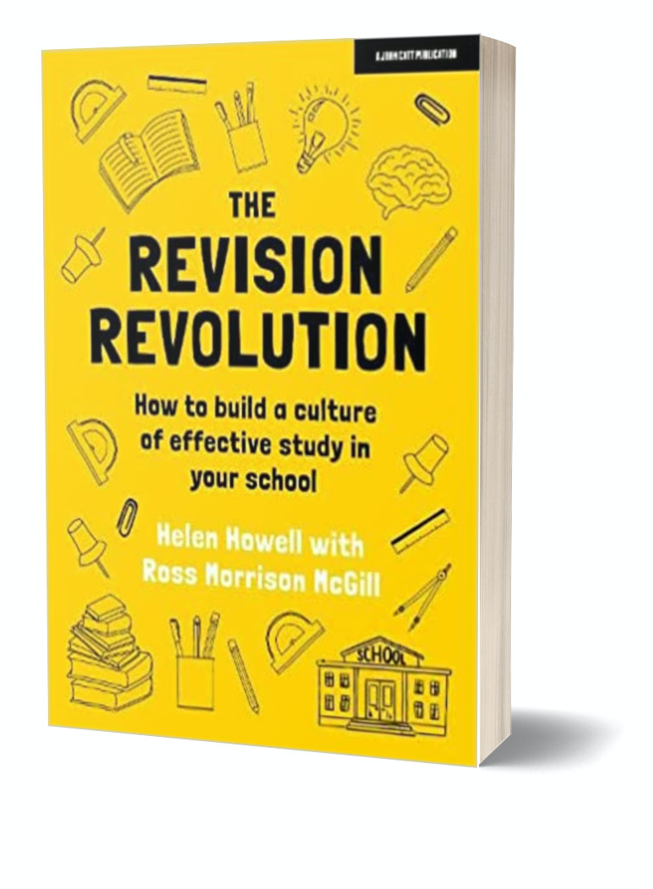
Key Takeaways:
1. Normalise effective study by starting early, demystifying the revision process.
2. Have a carefully-sequenced curriculum full of powerful knowledge worth revising!
3. Model effective study strategies as part of lessons and across subjects.
4. Give students repeated opportunities to practise effective study skills.
5. Consider a cognitive science curriculum through form, PSHE or assemblies.
helendora@gmail.com
@cura_dora

