Slide 1
How we Learn
How does memory work?

Slide 2
Retrieval Quiz
What does the word ‘revision’ actually mean?
List at least two ineffective study strategies and why they are ineffective.
List at least two effective study strategies and why they are effective.

Slide 3
Retrieval Quiz
Revision means to look (vision) again (re).
Ineffective study strategies include re-reading notes and highlighting as they are passive.
Effective study strategies include retrieving learning from memory with activities like brain dumps, flashcards and quizzes.

Slide 4
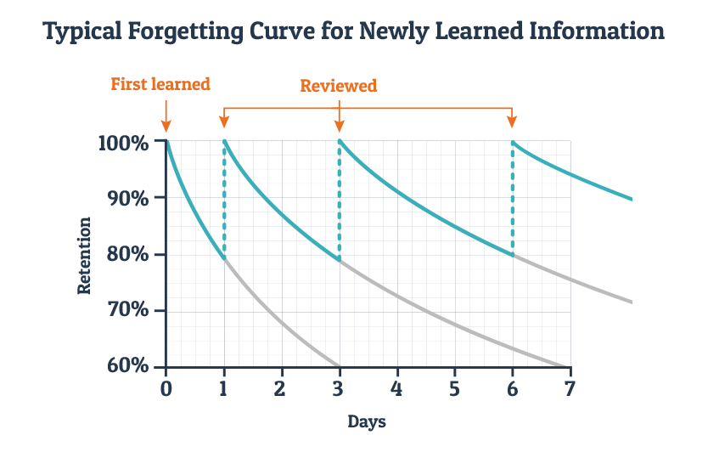
Ebbinghaus Forgetting Curve
Notes:
Explain to students that with learning, we either ‘use it or lose it’: unless learning is regularly reviewed (retrieval), we are very likely to forget it. Point out that this graph shows the impotance of spacing our reviews of learning for the best results which feeds into desirable difficulties that we will discuss later in today’s lesson.

Slide 5
Schema
Image of brain with dots and connecting lines.
Notes:
Explain to students that an item of knowledge in your schema is part of long-term memory. Schema organises different items of knowledge into groups that link together, helping us to understand new knowledge and making it more ’sticky’. Our schema should be constantly growing as the more items of linked knowledge we have, the stronger our memory and understanding becomes..

Slide 6
Schema
Image of spider web
Notes:
I like to use the analogy of a spider web here: the more connected pieces of web the spider spins, the stronger (and stickier!) his web becomes. Otherwise, it is fragile/vulnerable.

Slide 7
Tractors, Trains and Toddlers’ Schema!
Image of a tractor and a train?
Timed-Pair Share;
Partner A: teach the forgetting curve to your partner
Partner B: teach schema to your partner
You have 30 seconds each but if your partner gets stuck, make sure you question them. For example, why are toddler’s schemas less developed?
Notes:
I like to use an anecdote at this point to make the abstract concept of schema more concrete – of course you could substitute for your own schema anecdote here! My 2 year-old loves trains but he also has a toy tractor. His schema is not developed enough to tell the difference and he, therefore, insists his toy tractor is actually a train! According to his schema, they both have wheels and a carriage attached. His schema is not yet developed enough to recognise the difference in wheel size and shape, the fact that one drives on roads and fields and the other on a track... Neither has he had enough experiences of seeing tractors in our city setting!
Now students have had this input on the forgetting curve and schema, they should practise a generative learning strategies – teaching! Oracy is also cognitively sticky therefore you are modelling the tools you want students to use themselves as part of effective revision!
NB: I prefer a ‘timed-pair share’ to the traditional turn and talk or think-pair share because it gives both students an equal amount of time to respond so that no students can opt out. It is still important, of course, to allow think time prior to the discussion, however.

Slide 8
Trees
Notes:
Students write down everything they know about trees

Slide 9

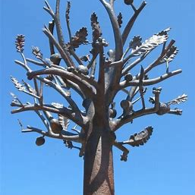

Trees
Notes:
Point out that their schema is developed enough (has enough different but connected items of knowledge) to identify all these very different types of trees as tress even the ones with no leaves as we know they shed these in the autumn. One of these is a sculpture but we still recognise it as a tree.

Slide 10
Cold-Calling Quiz!
What does the Ebbinghaus Forgetting Curve tell us about learning?
What is schema?
How does schema help us learn new information?
How can we build our schema?

Slide 11
Desirable (adj): worth having or getting
The prefix ‘de’ comes from the Latin to mean ‘down from’ and ‘desidere’ means ‘from the stars’ so to desire something originally meant awaiting what the stars would bring although this meaning has evolved and become more general to mean anything wished for and seen as worth having.
The house was in a desirable location.
The new oven has many desirable features such as a fan that makes it more efficient.
Kindness is a desirable personality trait.
What qualities are desirable in a friend? What do you think is your most desirable feature and why? Why might difficult learning be desirable?
Notes:
This slide is based on best practice in vocabulary teaching according to Beck: start with a student-friendly definition and then explore the origin of the word (our brains privilege stories so this makes the meaning more memorable). Next, show examples of the word in use in lots of different contexts so that students develop a broad and flexible understanding. Finally, comprehension questions that allow students immediate practice with the target word.

Slide 12
Desirable Difficulties
Desirable difficulties are learning tasks that require more effort; the reason this effort is ‘desirable’ is because it is much more effective for long-term learning.
Desirable difficulties include:
Spacing learning so it is more difficult to remember;
Interleaving different topics;
Varying the conditions;
Retrieving learning from memory with no cues.

Slide 13
Let’s create a desirable difficulty!
Close your book and discuss with your partner everything you both remember about the forgetting curve, schema and desirable difficulties.

Slide 14
How could we have made this even more difficult?
Discuss or write down everything we can remember about today’s lesson in a week, month or year (spacing).
Discuss or write down everything we can remember about today’s lesson after studying a different topic (interleaving).
Discuss or write down everything we can remember about today’s lesson in a different lesson or using a different method (varying conditions of practice).
How could you include desirable difficulties in your revision?
Notes:
Ideas for the final question: space revision out (revise a previous topic after a gap), interleave different topics into a study session, use retrieval (remembering learning with no cues) and vary the conditions by using a range of methods e.g. flashcards, quizzing with a friend, brain dump, teaching a family member…

